Slide 1
Trending YouTube Videos
Tara Graeve

Slide 2
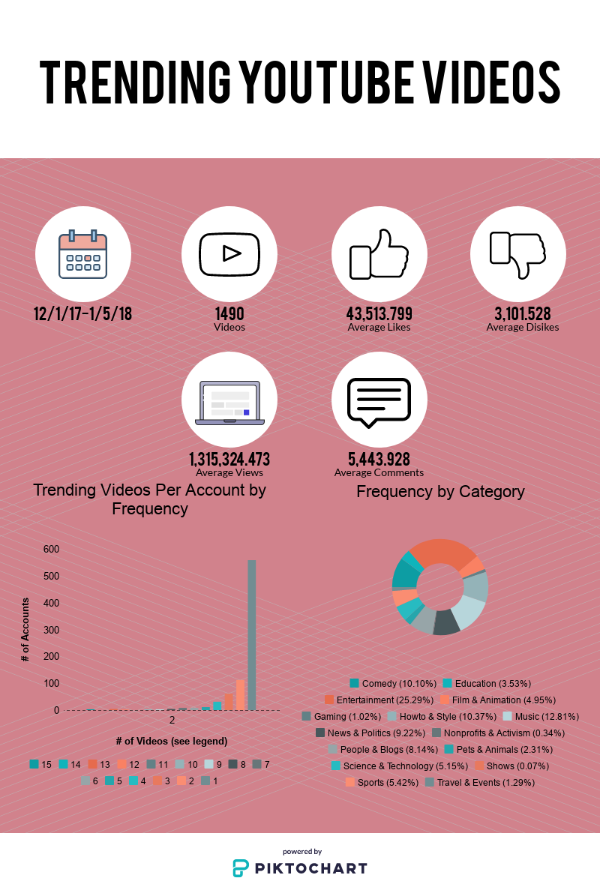

Slide 3
So What?
Hypothesis testing concluded that:
  average likes > average dislikes
  average views > average comments
  means across content categories are unequal
Use for marketing
  How do businesses strategically put out content that matches this?
  Businesses often partner with influencers—how can they choose people that fit with the trends?
  Advertising strategy—how can businesses reach more users?
  Align brands with content creators who fit the brand’s values and choose to sponsor the product, will reach a large viewer base, or are predicted to reach a large viewer base

